Slide 1


WiFi Watchdog
Isaac Lee, Michael Tao

Slide 2
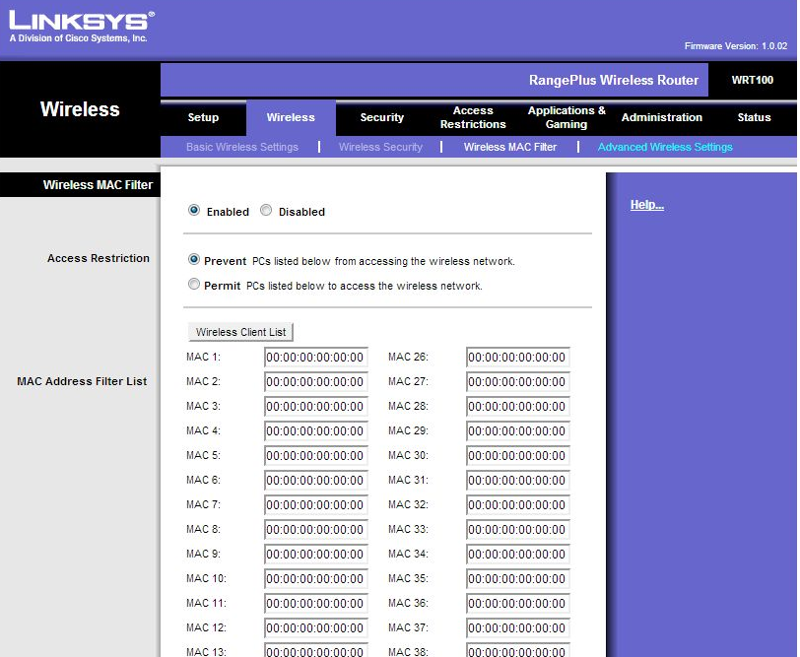
The Problem
You’re the owner of a small tech company and everybody just NEEDS WiFi access for “business” reasons
You have secure information on your network that you don’t want anyone else snooping in on
You also don’t want to hire IT to manually screen device usage or filter MAC addresses to prevent foreign access

Slide 3
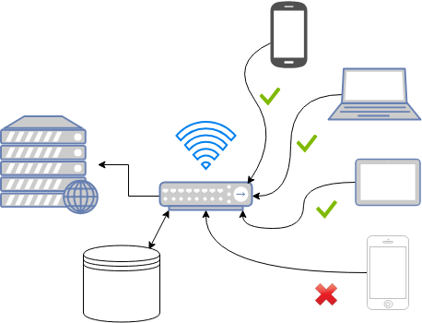

The Solution
A Raspberry Pi powered Wi-Fi sniffer that:
Uses machine learning to characterize authorized users on the network
Learns over time to develop an increasingly accurate model of users on the network
Identifies foreign access patterns inconsistent with known users

Slide 4
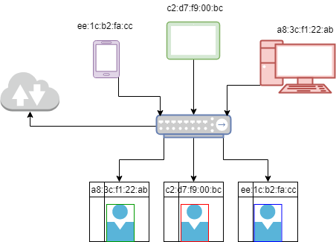
How it Works
The Raspberry Pi listens to all incoming and outgoing traffic and reads information such as size, destination IP, time when the packet was sent
It feeds this information into a custom designed classifier machine which then tries to learn each users’ usage

Slide 5
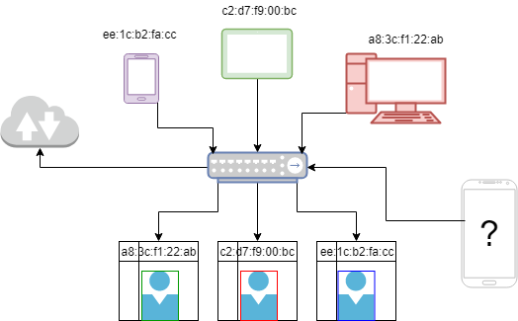
How it Works
When a new device accesses the network, the machine will attempt to identify if the usage patterns are consistent with an existing pattern
Otherwise alarms will sound

Slide 6

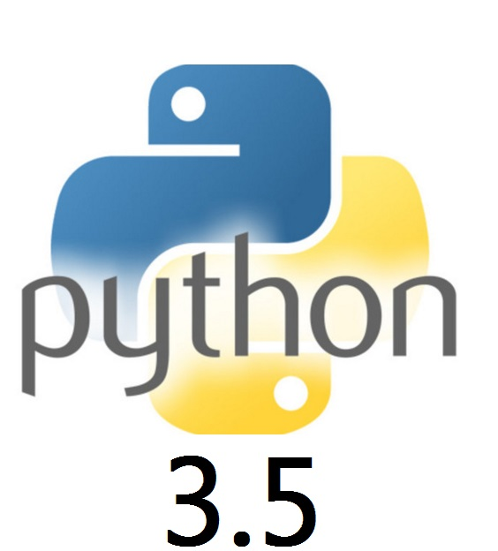
Coding and Algorithms
Supervised classification machine learning
Python backend which does packet sniffing using a pyShark library
CherryPy web based front end design

Slide 7
User Experience and Demonstration
SSID:
WiFi Watchdog
Password: ChipTeam

Slide 8
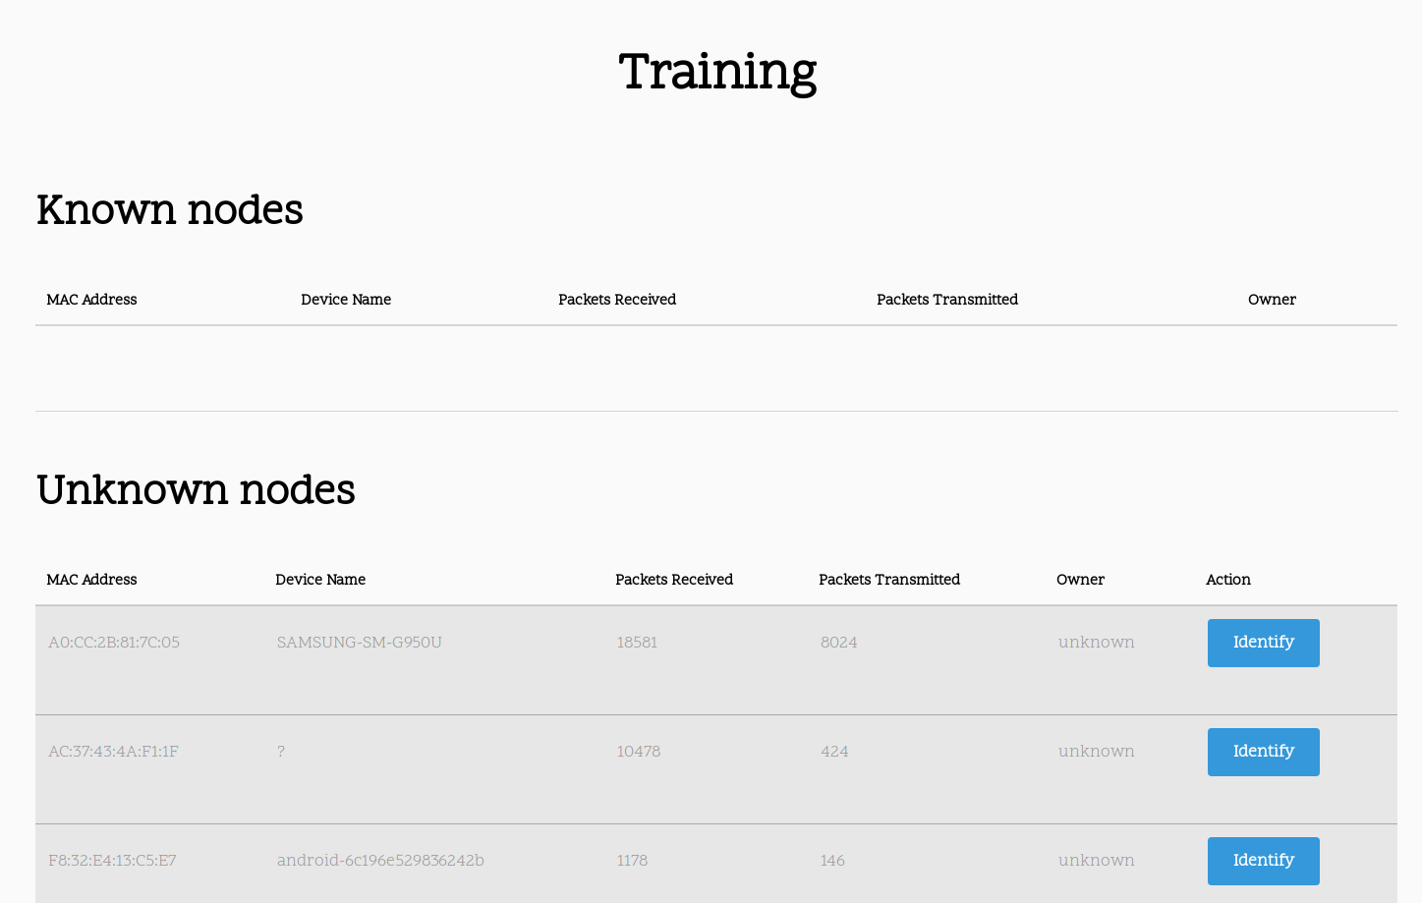
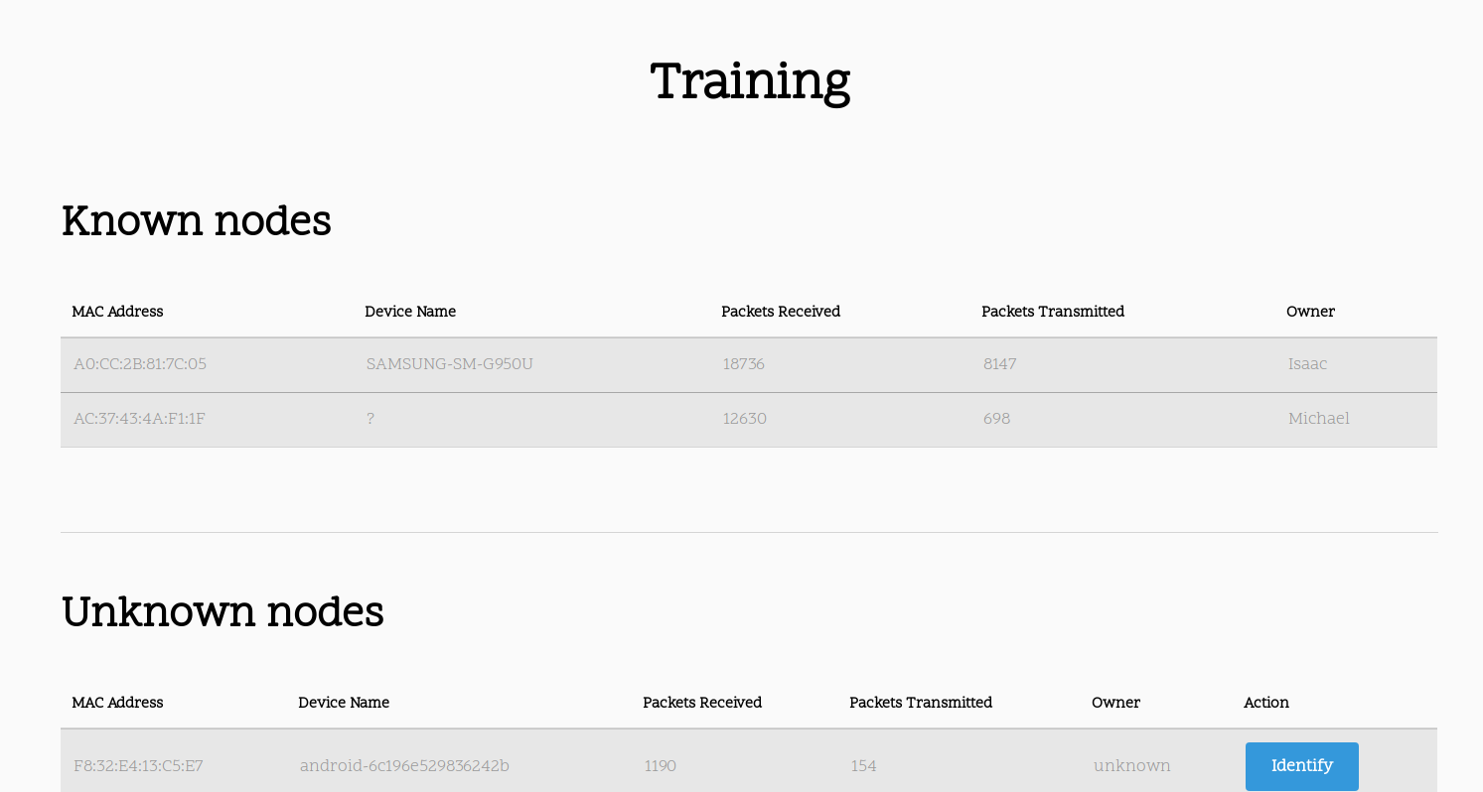
WiFi Watchdog monitors all connected devices immediately and teaches the algorithm about the device connected
However it does not know who the device belongs to
The user can Identify connected devices and assign an owner to them
WiFi Watchdog will now be able to know if future connections are related to existing users

Slide 9
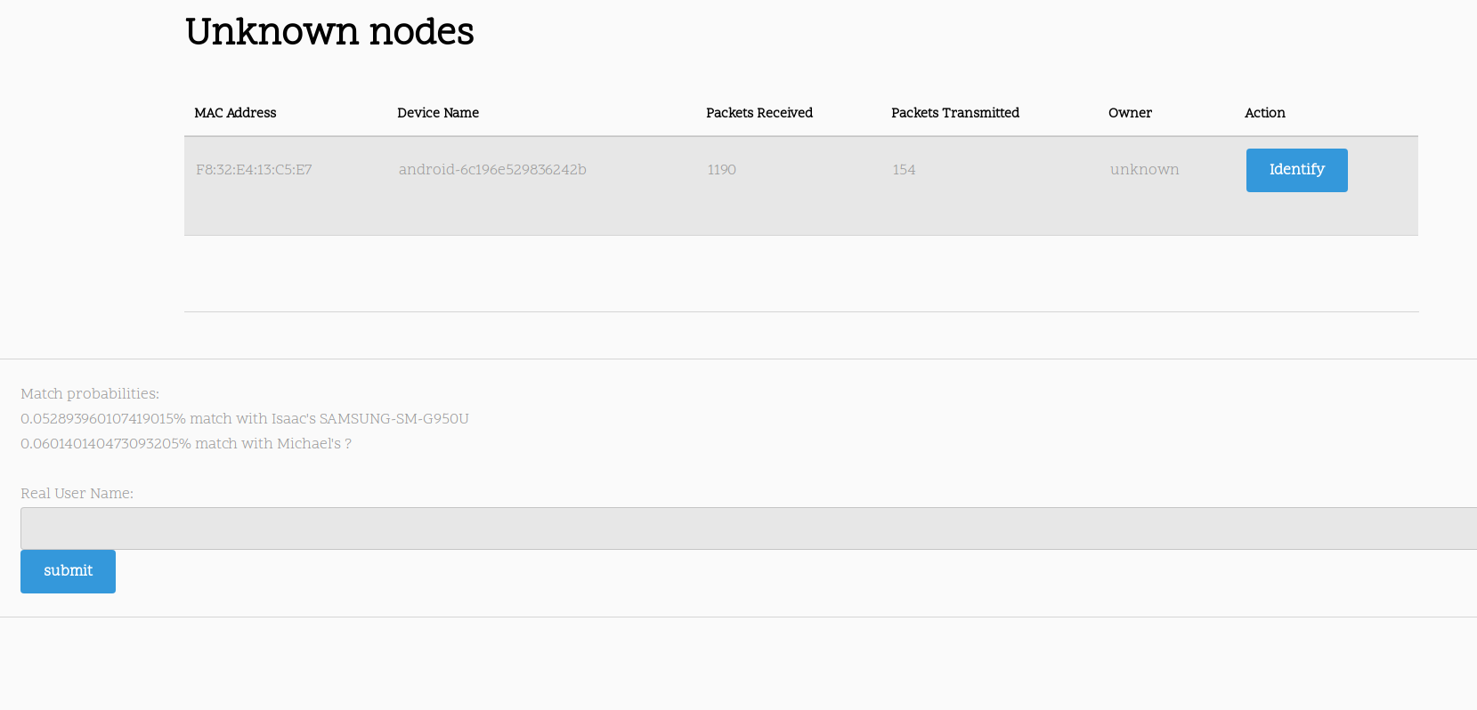
This new connection is unfamiliar, so WiFi Watchdog shows that the new device is a low match with existing users in the network

Slide 10

What we’d change
Given more time, we would like to implement a more complicated and robust machine learning algorithm such as a random forest classification algorithm
We would also like to get more data points to better characterize the machine

